Slide 1
MP 1 - Compressed Sensing Image Recovery
Jake Vigeant
March 5, 2023

Slide 2
Results

Slide 3
Sampling

Slide 4
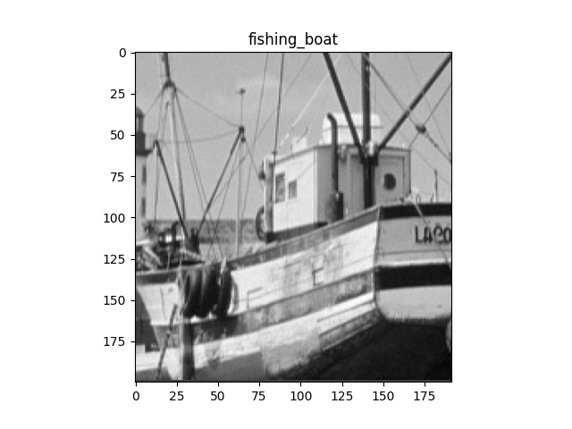
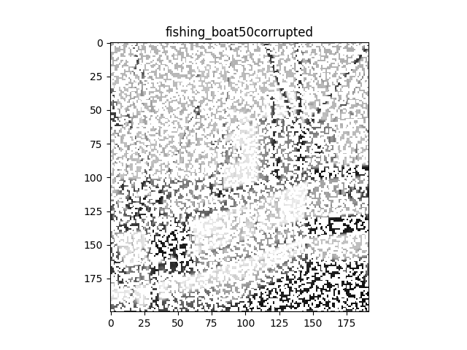
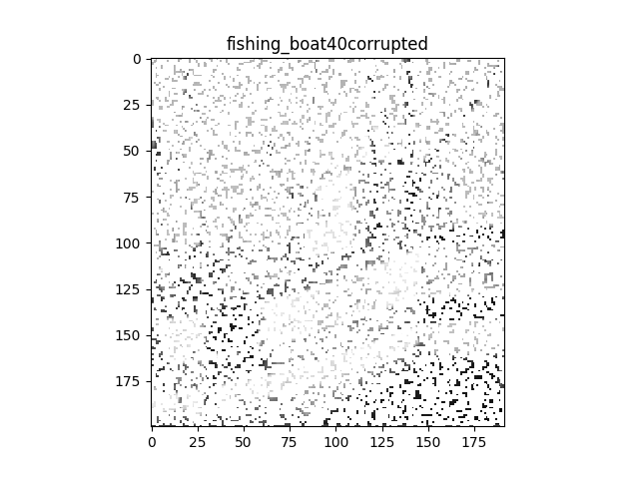
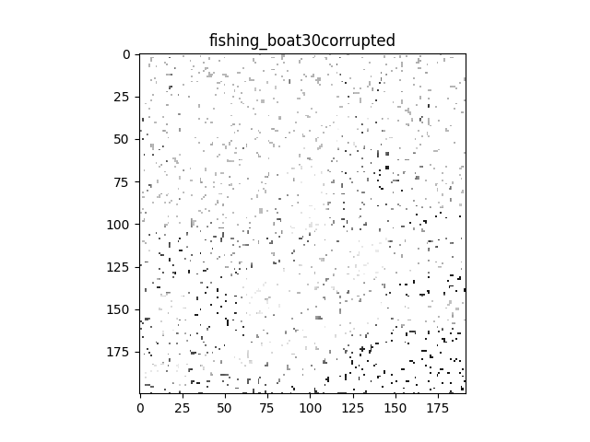
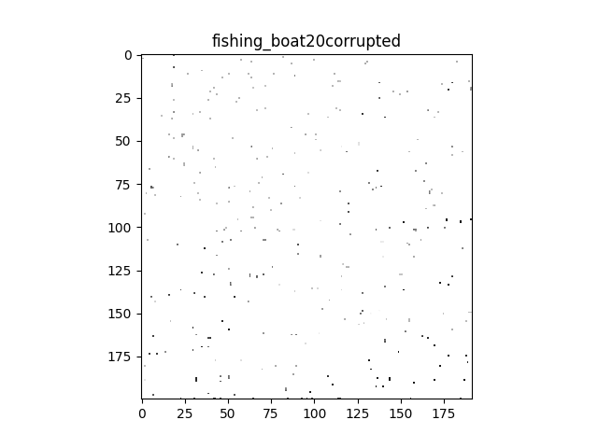
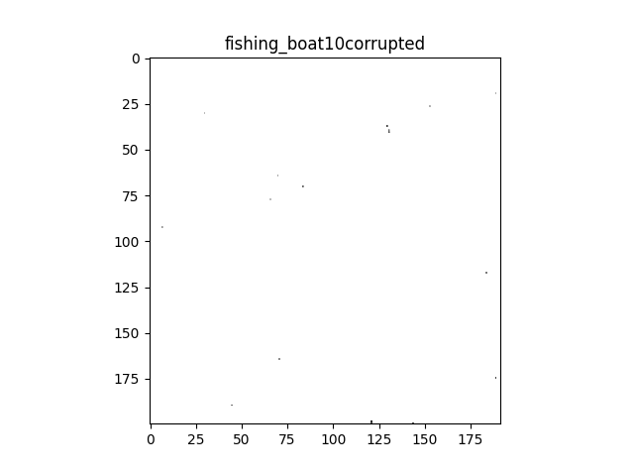
Fishing Boat
The images presented on this slide indicate the original image provided in the project and the corruptions performed thereafter. This image is a greyscale fishing boat. The 5 corrupted images illustrate potential images that may be received for regression-based reconstruction as in this project. The original image was corrupted block-by-block. The complete 200x192 fishing boat image was segmented into 8x8 contiguous and non-overlapping blocks. These blocks were then corrupted in successive levels as specified in the corrupted image titles. The S value represents the number of pixels to sense from each block. As a block contains 64 pixels, 64-S pixel indices were randomly selected and set to NaN in order to simulate corruption. The S values used are 50, 40, 30, 20, 10 as labeled in the image titles. As can be seen in the images, the higher the S value, the more perceptible the original image is. As S goes to 30 and lower it is impossible to recognize the original image.

Slide 5
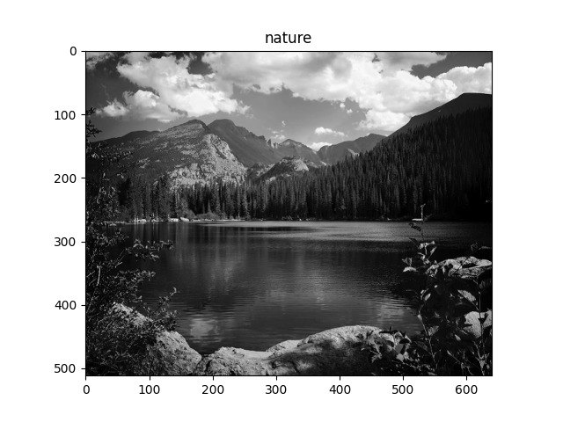
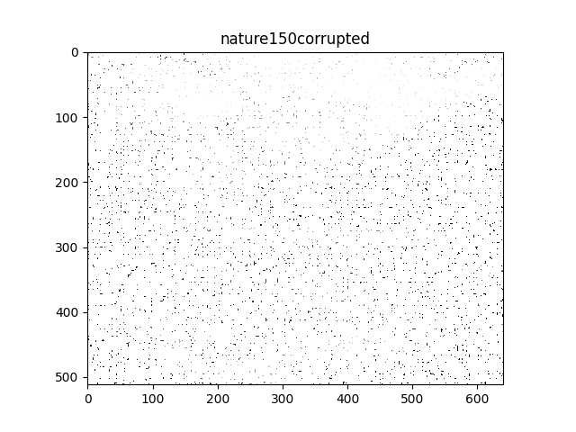
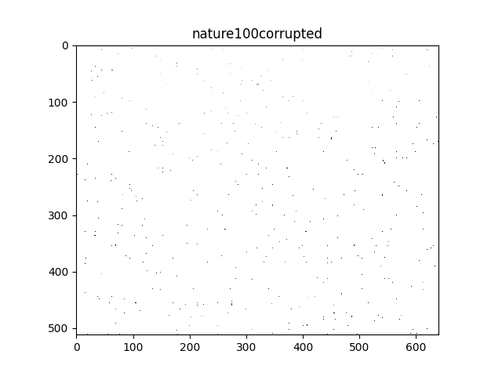

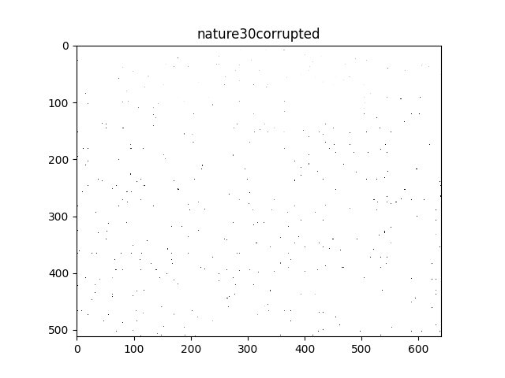
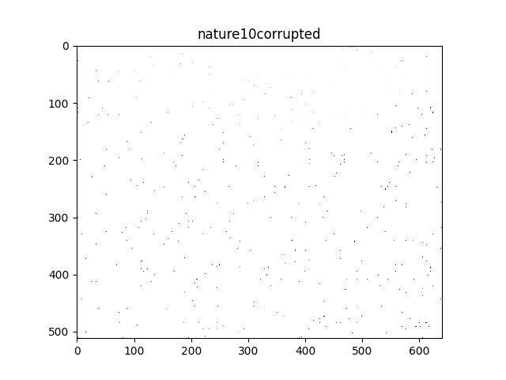
Nature
The images presented on this slide indicate the original image provided in the project and the corruptions performed thereafter. This image is a greyscale nature landscape. The 5 corrupted images illustrate potential images that may be received for regression-based reconstruction as in this project. The original 512x640 image was corrupted block-by-block. The complete nature image was segmented into 16x16 contiguous and non-overlapping blocks. These blocks were then corrupted in successive levels as specified in the corrupted image titles. The S value represents the number of pixels to sense from each block. As a block contains 256 pixels, 256-S pixel indices were randomly selected and set to NaN in order to simulate corruption. The S values used are 150, 100, 50, 30, and 10 as labeled in the image titles. As can be seen in the images, the higher the S value, the more perceptible the original image is. As S goes lower than 150, it is impossible to perceive the original image. The corruption seems to be more effective than in the fishing boat image, as none of the corrupted image convey much information about the original.

Slide 6
Block Level Reconstruction

Slide 7
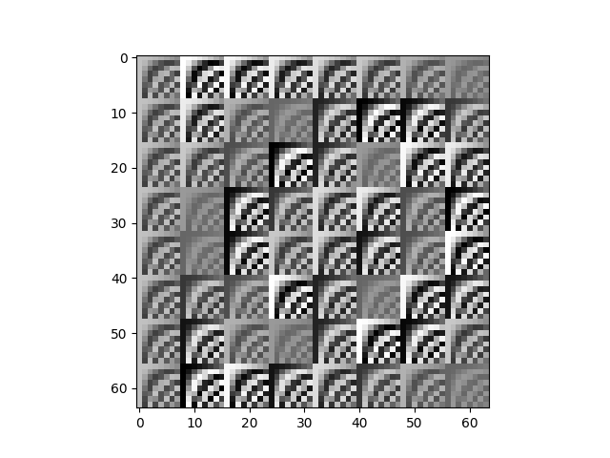
K=8 Basis Vectors
The image presented illustrates the basis vector matrix utilized for reconstructing the boat image. This image was generated to represent a basis vector matrix for the 8x8 case of the Discrete Cosine Transformation. This was generated by implementing the frequency and spatial formula for the transform in terms of frequencies u, v and spatial coordinates x, y. Moving across rows of the image contains variance in x and y, with u, and v constant. Over an 8 pixel block, x is constant and y will vary up to 8 moving horizontally. The frequency coordinates vary across a column while the x,y spatial coordinates are constant. The u value is constant for each 8 pixel block moving d0wn from 0 to 64, and v varies from 1 to 8 inside each constant u value block. The image was generated by visualizing the output matrix from calculating the transform value for each possible combination of the 4 variables, ranging each from 1 to 8 as the others stayed constant. This basis vector matrix provides a complete set of vectors needed to reconstruct any image that is corrupted in 8x8 blocks. The spatial and frequency variations across the matrix ensure this. Reconstructive tasks involve fitting a set of weights to this basis vector matrix for the present pixels, thereby representing the image reconstruction output as a weighted sum of these vectors.

Slide 8
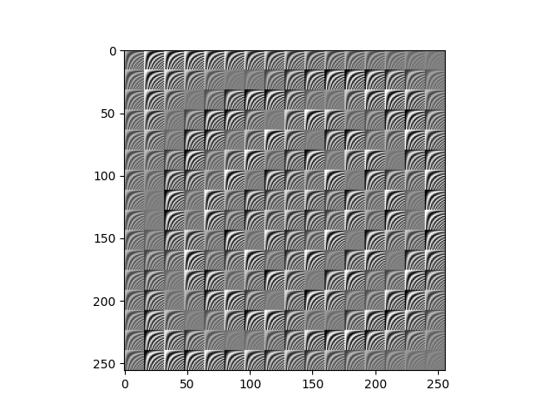
K=16 Basis Vectors
The image presented illustrates the basis vector matrix utilized for reconstructing the nature image. This image was generated to represent a basis vector matrix for the 16x16 case of the Discrete Cosine Transformation. This was generated by implementing the frequency and spatial formula for the transform in terms of frequencies u, v and spatial coordinates x, y. Moving across rows of the image contains variance in x and y, with u, and v constant. Over a 16 pixel block, x is constant and y will vary up to 16 moving horizontally. The frequency coordinates vary across a column while the x,y spatial coordinates are constant. The u value is constant for each 16 pixel block moving d0wn from 1 to 256, and v varies from 1 to 16 inside each constant u value block. The image was generated by visualizing the output matrix from calculating the transform value for each possible combination of the 4 variables, ranging each from 1 to 16 as the others stayed constant. This basis vector matrix provides a complete set of vectors needed to reconstruct any image that is corrupted in 16x16 blocks. The spatial and frequency variations across the matrix ensure this. Reconstructive tasks involve fitting a set of weights to this basis vector matrix for the present pixels, thereby representing the image reconstruction output as a weighted sum of these vectors.

Slide 9
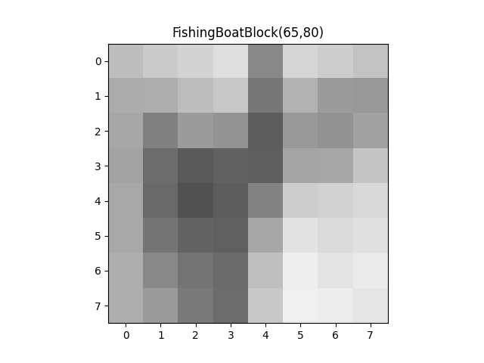
Sample Block From Original Fishing Boat Image
This image represents a sample block taken from the original fishing boat image. Visualizing this block helps understand the block-wise nature of the image recovery process. The block was generated by slicing the original image matrix at the indices beginning with the upper left corner, and ranging by 8 , the block size, along both the x and y direction. A new, 8x8 matrix was initialized with these pixel values for use in the corruption and reconstruction processes. The upper left-hand coordinate of this block is 65,80. This block was selected from the region of the image with the boat’s grey and white stripes in order to showcase reconstruction on a non-trivial, high variance block.

Slide 10
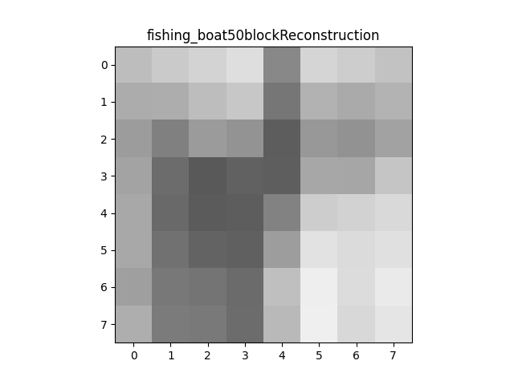
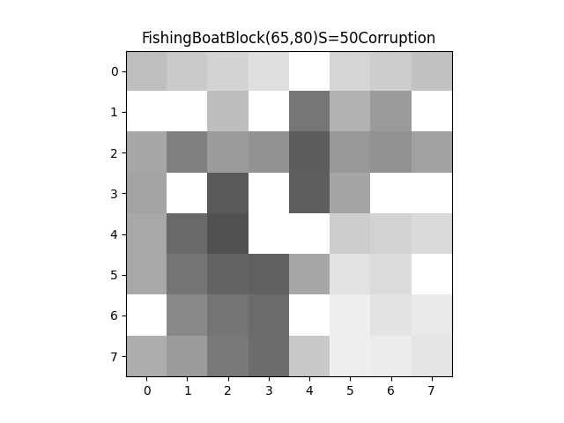
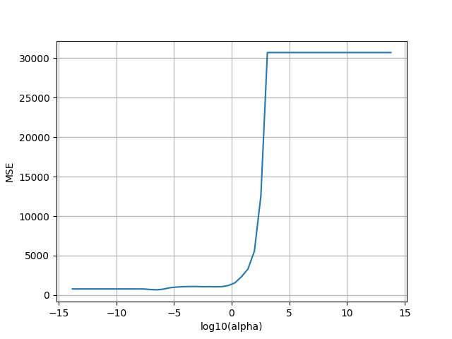
Fishing Boat Block Reconstruction (S=50)
The images presented on this slide illustrate the full reconstruction for the block of the fishing boat image shown on the previous slide. The corruption process was performed on the block, with 50 of the 64 pixels left sensed. 14 pixels were selected at random and set to NaN to simulate data loss and corruption. The result is shown in the upper left image. Then, the image was reconstructed using LASSO regression, resulting in the upper right plot. The corrupted image was rasterized to produce a column vector. Then, the basis vector matrix was modified to only include the basis vectors whose x, y position correspond to the valid pixels in the corrupted image. Next, random subset cross validation was performed to select a regularization parameter for the block. The sensed pixels were grouped into training and testing folds. Floor(S/6) pixels were drawn for the testing fold at random. In this case, floor(50/6) = 8. The remaining 42 of the sensed pixels were used to train the model (50-8) . This process was repeated 20 times to produce a model resistant to specific datapoint variance. Alpha values ranged from 10^-6 to 10^6, with 3 values per log decade. Then, a Lasso regularization model was fit to the training fold using SciKitLearn’s Lasso model for each alpha value. This model did not fit an intercept so that the bias would not offset the pixel values and produce poor results. The input features X, are the basis vectors corresponding to the sensed pixels that were grouped into the training fold. The input labels are the corresponding pixel values for these training pixels. The LASSO model fits a set of weight coefficients to the basis vector matrix so that each pixel value can be represented as a weighted sum of the basis vectors. The performance of each model was analyzed by computing the Mean Square Error (Difference in pixel prediction and actual value in the image squared, averaged across the total number of predicted pixels) across the testing pixels. The model performance versus regularization parameter value is depicted in the bottom right plot. It was generated from this list of model scores versus alpha values within a block. As can be seen, the value of alpha that minimized the MSE was ~10^-6. This optimal model was then selected as the model to reconstruct the missing pixels. The dot product of the weight vector from the optimal LASSO model and the basis vector corresponding to the x,y position of each missing pixel yielded the reconstructed pixel value. The image in the top right illustrates the reconstruction of the block using this method. Comparing to the original block on the previous slide, the reconstruction performance is good. The blocks appear cl0se to identical to the naked eye if 50 of the 64 pixels are sensed in the corruption process.
Corrupted Block

Slide 11
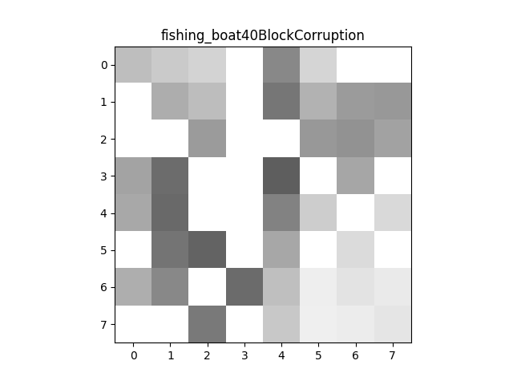
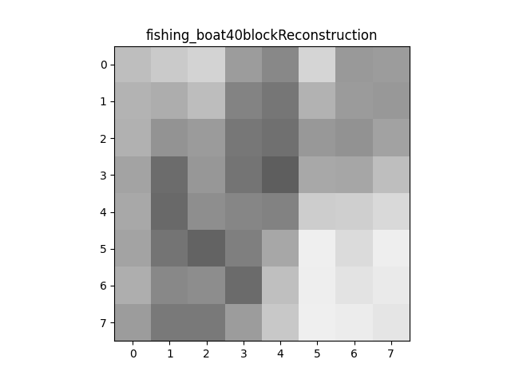
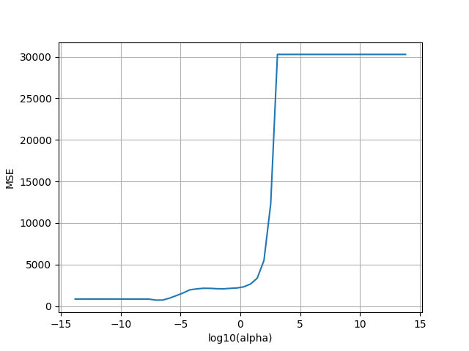
Fishing Boat Block Reconstruction (S=40)
The images presented on this slide illustrate the full reconstruction for the block of the fishing boat image shown on the previous slide. The corruption process was performed on the block, with 40 of the 64 pixels left sensed. 24 pixels were selected at random and set to NaN to simulate data loss and corruption. The result is shown in the upper left image. Then, the image was reconstructed using LASSO regression, resulting in the upper right plot. The corrupted image was rasterized to produce a column vector. Then, the basis vector matrix was modified to only include the basis vectors whose x, y position correspond to the valid pixels in the corrupted image. Next, random subset cross validation was performed to select a regularization parameter for the block. The sensed pixels were grouped into training and testing folds. Floor(S/6) pixels were drawn for the testing fold at random. In this case, floor(40/6) = 6. The remaining 34 of the sensed pixels were used to train the model (40-6) . This process was repeated 20 times to produce a model resistant to specific datapoint variance. Alpha values ranged from 10^-6 to 10^6, with 3 values per log decade. Then, a Lasso regularization model was fit to the training fold using SciKitLearn’s Lasso model for each alpha value. This model did not fit an intercept so that the bias would not offset the pixel values and produce poor results. The input features X, are the basis vectors corresponding to the sensed pixels that were grouped into the training fold. The input labels are the corresponding pixel values for these training pixels. The LASSO model fits a set of weight coefficients to the basis vector matrix so that each pixel value can be represented as a weighted sum of the basis vectors. The performance of each model was analyzed by computing the Mean Square Error (Difference in pixel prediction and actual value in the image squared, averaged across the total number of predicted pixels) across the testing pixels. The model performance versus regularization parameter value is depicted in the bottom right plot. It was generated from this list of model scores versus alpha values within a block. As can be seen, the value of alpha that minimized the MSE was ~10^-6. This optimal model was then selected as the model to reconstruct the missing pixels. The dot product of the weight vector from the optimal LASSO model and the basis vector corresponding to the x, y position of each missing pixel yielded the reconstructed pixel value. The image in the top right illustrates the reconstruction of the block using this method. Comparing to the original block on the previous slide, the reconstruction performance is acceptable. The block appears to convey the general color shifts of the original block, but some pixels are clearly miscolored, whether too dark or too bright. This performance is clearly worse than the S=50 case. The corrupted block indicates a general outline of the color pattern in the original block despite the missing pixels, so this reconstruction result makes sense.
Corrupted Block

Slide 12
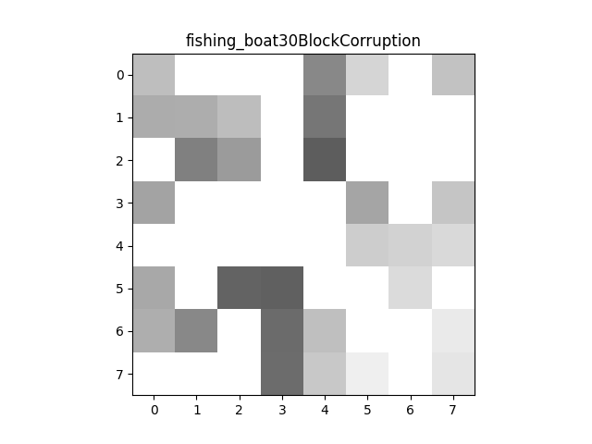
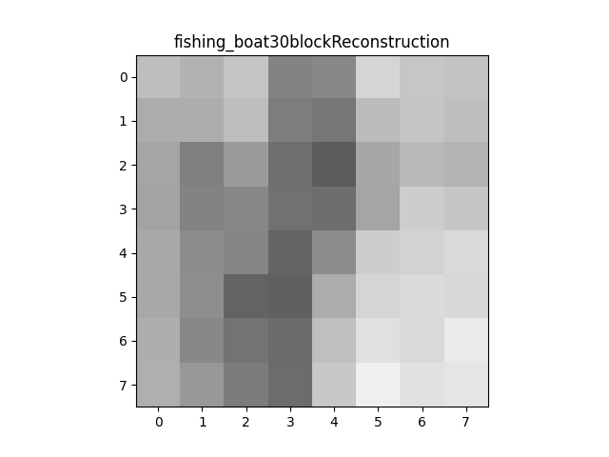
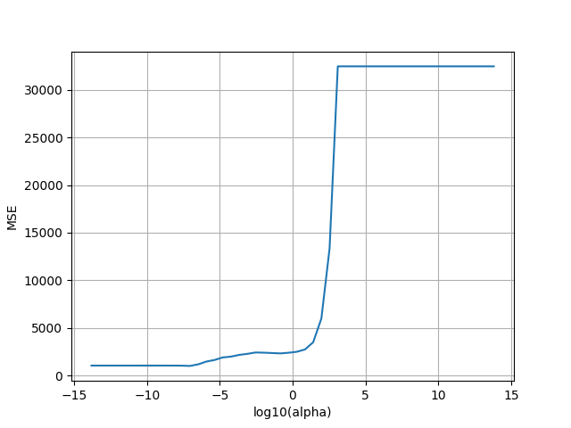
Fishing Boat Block Reconstruction (S=30)
The images presented on this slide illustrate the full reconstruction for the block of the fishing boat image shown on the previous slide. The corruption process was performed on the block, with 30 of the 64 pixels left sensed. 34 pixels were selected at random and set to NaN to simulate data loss and corruption. The result is shown in the upper left image. Then, the image was reconstructed using LASSO regression, resulting in the upper right plot. The corrupted image was rasterized to produce a column vector. Then, the basis vector matrix was modified to only include the basis vectors whose x, y position correspond to the valid pixels in the corrupted image. Next, random subset cross validation was performed to select a regularization parameter for the block. The sensed pixels were grouped into training and testing folds. Floor(S/6) pixels were drawn for the testing fold at random. In this case, floor(30/6) = 5. The remaining 25 of the sensed pixels were used to train the model (30-5) . This process was repeated 20 times to produce a model resistant to specific datapoint variance. Alpha values ranged from 10^-6 to 10^6, with 3 values per log decade. Then, a Lasso regularization model was fit to the training fold using SciKitLearn’s Lasso model for each alpha value. This model did not fit an intercept so that the bias would not offset the pixel values and produce poor results. The input features X, are the basis vectors corresponding to the sensed pixels that were grouped into the training fold. The input labels are the corresponding pixel values for these training pixels. The LASSO model fits a set of weight coefficients to the basis vector matrix so that each pixel value can be represented as a weighted sum of the basis vectors. The performance of each model was analyzed by computing the Mean Square Error (Difference in pixel prediction and actual value in the image squared, averaged across the total number of predicted pixels) across the testing pixels. The model performance versus regularization parameter value is depicted in the bottom right plot. It was generated from this list of model scores versus alpha values within a block. As can be seen, the value of alpha that minimized the MSE was ~10^-6. This optimal model was then selected as the model to reconstruct the missing pixels. The dot product of the weight vector from the optimal LASSO model and the basis vector corresponding to the x, y position of each missing pixel yielded the reconstructed pixel value. The image in the top right illustrates the reconstruction of the block using this method. Comparing to the original block on the previous slide, the reconstruction performance is acceptable. The block appears to convey the general color shifts of the original block, but some pixels are clearly miscolored, whether too dark or too bright. This leads to a blurred effect on the original block. This performance is visually worse than the S=40 case. The corrupted block is missing too many pixels to perceive the shape of the color pattern in the original block, so this reconstructive performance is surprising.
Corrupted Block

Slide 13
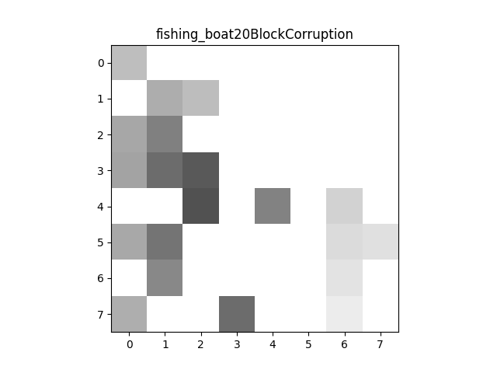
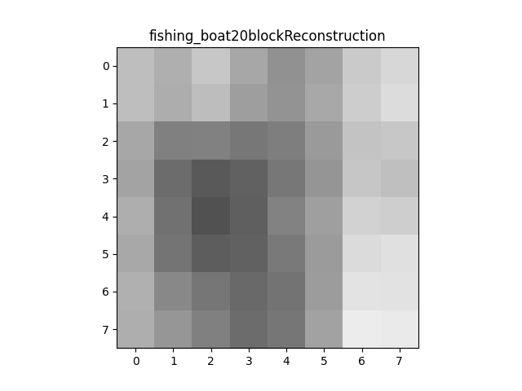
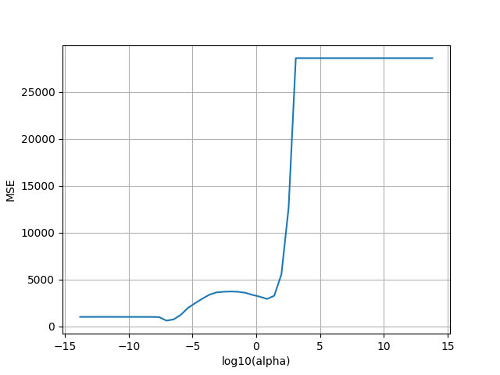
Fishing Boat Block Reconstruction (S=20)
The images presented on this slide illustrate the full reconstruction for the block of the fishing boat image shown on the previous slide. The corruption process was performed on the block, with 20 of the 64 pixels left sensed. 44 pixels were selected at random and set to NaN to simulate data loss and corruption. The result is shown in the upper left image. Then, the image was reconstructed using LASSO regression, resulting in the upper right plot. The corrupted image was rasterized to produce a column vector. Then, the basis vector matrix was modified to only include the basis vectors whose x, y position correspond to the valid pixels in the corrupted image. Next, random subset cross validation was performed to select a regularization parameter for the block. The sensed pixels were grouped into training and testing folds. Floor(S/6) pixels were drawn for the testing fold at random. In this case, floor(20/6) = 3. The remaining 17 of the sensed pixels were used to train the model (20-3) . This process was repeated 20 times to produce a model resistant to specific datapoint variance. Alpha values ranged from 10^-6 to 10^6, with 3 values per log decade. Then, a Lasso regularization model was fit to the training fold using SciKitLearn’s Lasso model for each alpha value. This model did not fit an intercept so that the bias would not offset the pixel values and produce poor results. The input features X, are the basis vectors corresponding to the sensed pixels that were grouped into the training fold. The input labels are the corresponding pixel values for these training pixels. The LASSO model fits a set of weight coefficients to the basis vector matrix so that each pixel value can be represented as a weighted sum of the basis vectors. The performance of each model was analyzed by computing the Mean Square Error (Difference in pixel prediction and actual value in the image squared, averaged across the total number of predicted pixels) across the testing pixels. The model performance versus regularization parameter value is depicted in the bottom right plot. It was generated from this list of model scores versus alpha values within a block. As can be seen, the value of alpha that minimized the MSE was ~10^-6. This optimal model was then selected as the model to reconstruct the missing pixels. The dot product of the weight vector from the optimal LASSO model and the basis vector corresponding to the x, y position of each missing pixel yielded the reconstructed pixel value. The image in the top right illustrates the reconstruction of the block using this method. Comparing to the original block on the previous slide, the reconstruction performance is acceptable. The block appears to convey the general color shifts of the original block, but some pixels are clearly miscolored, whether too dark or too bright. This leads to a blurred effect on the original block. This performance is visually worse than the S=30 case. The corrupted block provides nearly no information on the original block to the human eye, so this result is surprising. The upper right grey gradient in the reconstructed image is most impressive, as all of these pixels are missing in the corrupted block.
Corrupted Block

Slide 14
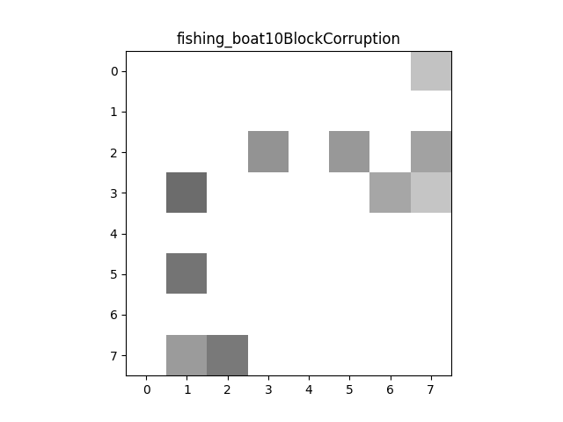
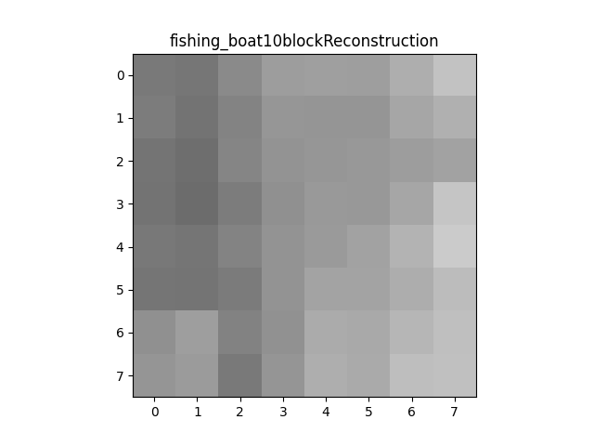
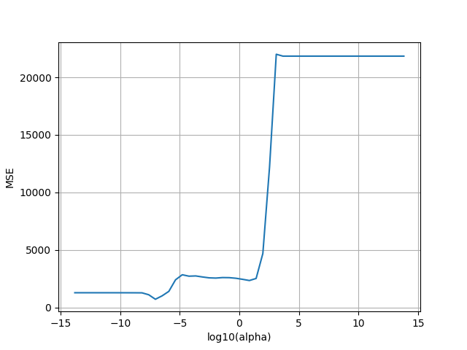
Fishing Boat Block Reconstruction (S=10)
The images presented on this slide illustrate the full reconstruction for the block of the fishing boat image shown on the previous slide. The corruption process was performed on the block, with 10 of the 64 pixels left sensed. 54 pixels were selected at random and set to NaN to simulate data loss and corruption. The result is shown in the upper left image. Then, the image was reconstructed using LASSO regression, resulting in the upper right plot. The corrupted image was rasterized to produce a column vector. Then, the basis vector matrix was modified to only include the basis vectors whose x, y position correspond to the valid pixels in the corrupted image. Next, random subset cross validation was performed to select a regularization parameter for the block. The sensed pixels were grouped into training and testing folds. Floor(S/6) pixels were drawn for the testing fold at random. In this case, floor(10/6) = 1. The remaining 9 of the sensed pixels were used to train the model (10-9) . This process was repeated 20 times to produce a model resistant to specific datapoint variance. Alpha values ranged from 10^-6 to 10^6, with 3 values per log decade. Then, a Lasso regularization model was fit to the training fold using SciKitLearn’s Lasso model for each alpha value. This model did not fit an intercept so that the bias would not offset the pixel values and produce poor results. The input features X, are the basis vectors corresponding to the sensed pixels that were grouped into the training fold. The input labels are the corresponding pixel values for these training pixels. The LASSO model fits a set of weight coefficients to the basis vector matrix so that each pixel value can be represented as a weighted sum of the basis vectors. The performance of each model was analyzed by computing the Mean Square Error (Difference in pixel prediction and actual value in the image squared, averaged across the total number of predicted pixels) across the testing pixels. The model performance versus regularization parameter value is depicted in the bottom right plot. It was generated from this list of model scores versus alpha values within a block. As can be seen, the value of alpha that minimized the MSE was ~10^-6. This optimal model was then selected as the model to reconstruct the missing pixels. The dot product of the weight vector from the optimal LASSO model and the basis vector corresponding to the x, y position of each missing pixel yielded the reconstructed pixel value. The image in the top right illustrates the reconstruction of the block using this method. Comparing to the original block on the previous slide, the reconstruction performance is visually poor. The reconstruction exhibits a blovk-wide grey gradient moving left to right, failing to include the shape and edges present in the initial uncorrupted block. This is not surprising, as upon visual inspection, the corrupted block does not offer much information on the initial block.
Corrupted Block

Slide 15
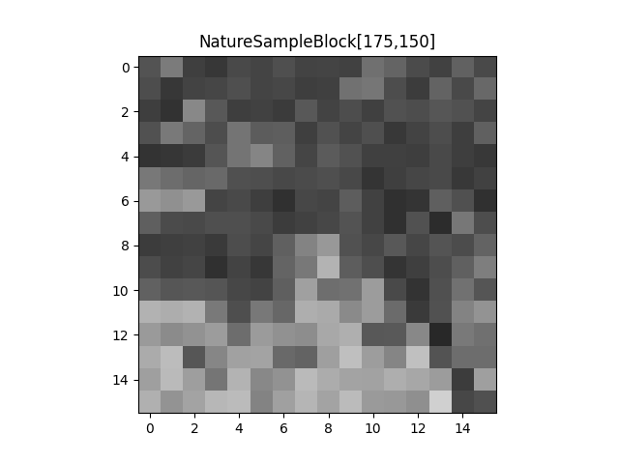
Sample Block From Original NatureImage
This image represents a sample block taken from the original nature image. Visualizing this block helps understand the block-wise nature of the image recovery process. The block was generated by slicing the original image matrix at the indices beginning with the upper left corner, and ranging by 16, the block size, along both the x and y direction. A new, 16x16 matrix was initialized with these pixel values for use in the corruption and reconstruction processes. The upper left-hand coordinate of this block is 175,150. This block was selected from the region of the image with the intersection of the water and forest landscape in order to provide a nontrivial reconstructive task with high pixel variance.

Slide 16
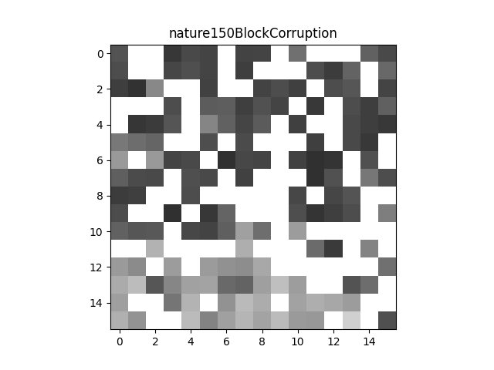
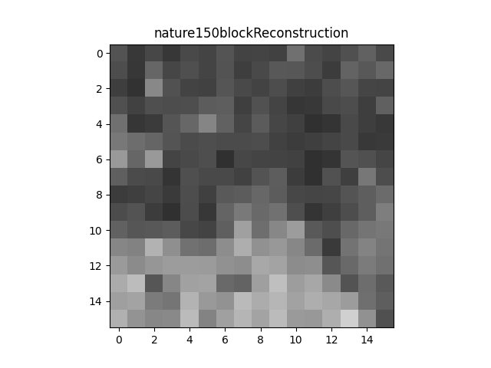
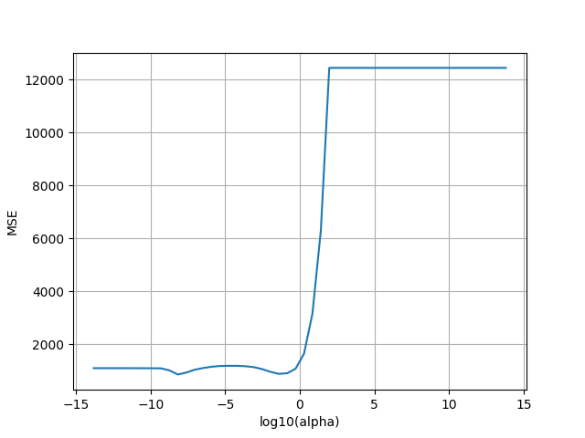
Nature Block Reconstruction (S=150)
The images presented on this slide illustrate the full reconstruction for the block of the nature image shown on the previous slide. The corruption process was performed on the block, with 150 of the 256 pixels left sensed. 106 pixels were selected at random and set to NaN to simulate data loss and corruption. The result is shown in the upper left image. Then, the image was reconstructed using LASSO regression, resulting in the upper right plot. The corrupted image was rasterized to produce a column vector. Then, the basis vector matrix was modified to only include the basis vectors whose x, y position correspond to the valid pixels in the corrupted image. Next, random subset cross validation was performed to select a regularization parameter for the block. The sensed pixels were grouped into training and testing folds. Floor(S/6) pixels were drawn for the testing fold at random. In this case, floor(150/6) = 25. The remaining 125 of the sensed pixels were used to train the model (150-25) . This process was repeated 20 times to produce a model resistant to specific datapoint variance. Alpha values ranged from 10^-6 to 10^6, with 3 values per log decade. Then, a Lasso regularization model was fit to the training fold using SciKitLearn’s Lasso model for each alpha value. This model did not fit an intercept so that the bias would not offset the pixel values and produce poor results. The input features X, are the basis vectors corresponding to the sensed pixels that were grouped into the training fold. The input labels are the corresponding pixel values for these training pixels. The LASSO model fits a set of weight coefficients to the basis vector matrix so that each pixel value can be represented as a weighted sum of the basis vectors. The performance of each model was analyzed by computing the Mean Square Error (Difference in pixel prediction and actual value in the image squared, averaged across the total number of predicted pixels) across the testing pixels. The model performance versus regularization parameter value is depicted in the bottom right plot. It was generated from this list of model scores versus alpha values within a block. As can be seen, the value of alpha that minimized the MSE was ~10^-2. This optimal model was then selected as the model to reconstruct the missing pixels. The dot product of the weight vector from the optimal LASSO model and the basis vector corresponding to the x,y position of each missing pixel yielded the reconstructed pixel value. The image in the top right illustrates the reconstruction of the block using this method. Comparing to the original block on the previous slide, the reconstruction performance is good. The blocks appear cl0se to identical to the naked eye. There are point-wise discrepancies in the pixels, but the overall shapes and gradients from the original block are reproduced faithfully in the reconstruction.
Corrupted Block

Slide 17
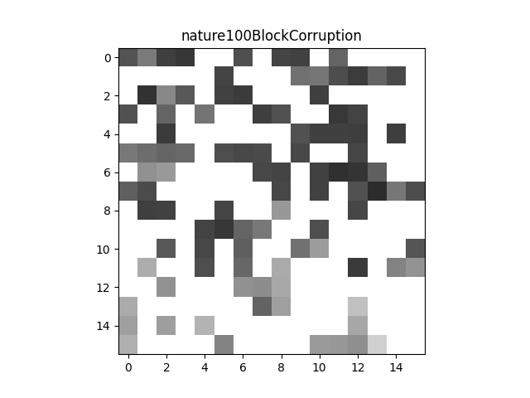
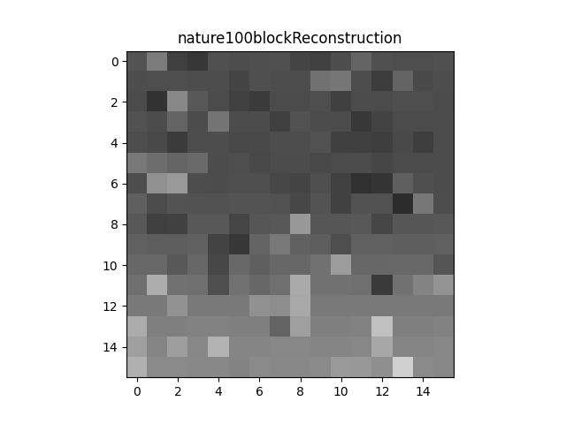
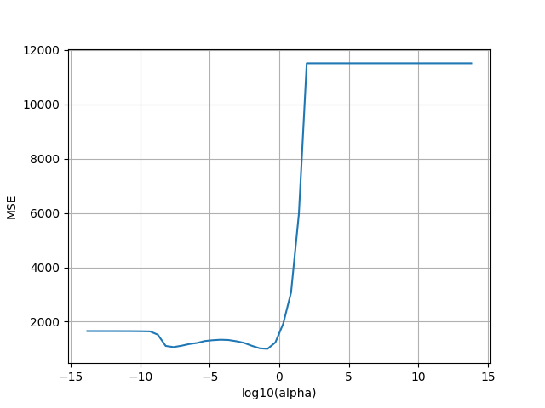
Nature Block Reconstruction (S=100)
The images presented on this slide illustrate the full reconstruction for the block of the nature image shown on the previous slide. The corruption process was performed on the block, with 100 of the 256 pixels left sensed. 156 pixels were selected at random and set to NaN to simulate data loss and corruption. The result is shown in the upper left image. Then, the image was reconstructed using LASSO regression, resulting in the upper right plot. The corrupted image was rasterized to produce a column vector. Then, the basis vector matrix was modified to only include the basis vectors whose x, y position correspond to the valid pixels in the corrupted image. Next, random subset cross validation was performed to select a regularization parameter for the block. The sensed pixels were grouped into training and testing folds. Floor(S/6) pixels were drawn for the testing fold at random. In this case, floor(100/6) = 16. The remaining 84 of the sensed pixels were used to train the model (100-16) . This process was repeated 20 times to produce a model resistant to specific datapoint variance. Alpha values ranged from 10^-6 to 10^6, with 3 values per log decade. Then, a Lasso regularization model was fit to the training fold using SciKitLearn’s Lasso model for each alpha value. This model did not fit an intercept so that the bias would not offset the pixel values and produce poor results. The input features X, are the basis vectors corresponding to the sensed pixels that were grouped into the training fold. The input labels are the corresponding pixel values for these training pixels. The LASSO model fits a set of weight coefficients to the basis vector matrix so that each pixel value can be represented as a weighted sum of the basis vectors. The performance of each model was analyzed by computing the Mean Square Error (Difference in pixel prediction and actual value in the image squared, averaged across the total number of predicted pixels) across the testing pixels. The model performance versus regularization parameter value is depicted in the bottom right plot. It was generated from this list of model scores versus alpha values within a block. As can be seen, the value of alpha that minimized the MSE was ~10^-2. This optimal model was then selected as the model to reconstruct the missing pixels. The dot product of the weight vector from the optimal LASSO model and the basis vector corresponding to the x,y position of each missing pixel yielded the reconstructed pixel value. The image in the top right illustrates the reconstruction of the block using this method. Comparing to the original block on the previous slide, the reconstruction performance is mediocre. The bottom portion of the image is not light or sharp enough, failing to convey the border between the water and the backdrop that is captured in this specific block. The edge appears very much blurred and softened. Above that, the overall greyscale variance is preserved, but the smaller inter-pixel shifts are not captured. This result makes sense as the corrupted block does not accurately depict these features of the original block.
Corrupted Block

Slide 18
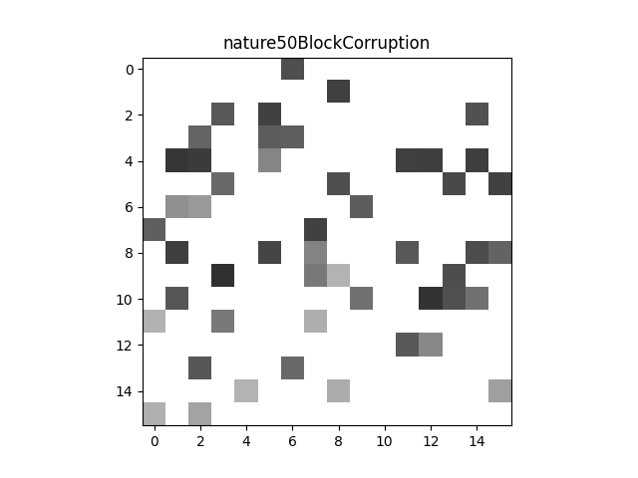
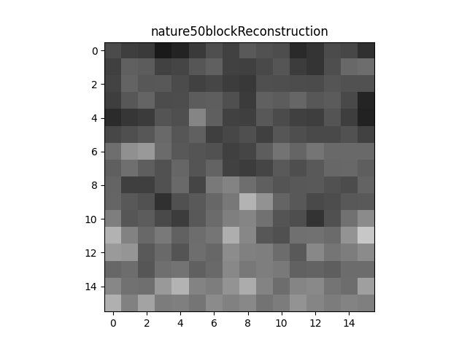
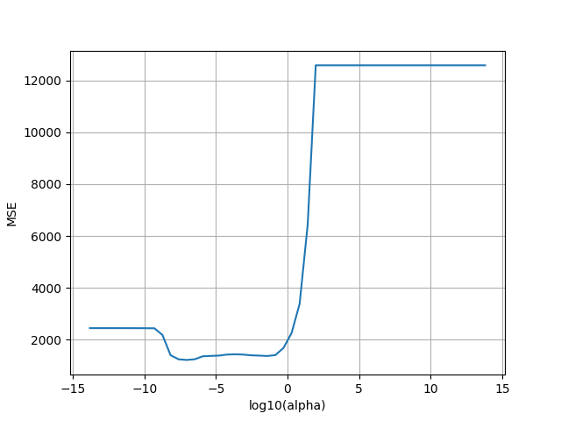
Nature Block Reconstruction (S=50)
The images presented on this slide illustrate the full reconstruction for the block of the nature image shown on the previous slide. The corruption process was performed on the block, with 50 of the 256 pixels left sensed. 206 pixels were selected at random and set to NaN to simulate data loss and corruption. The result is shown in the upper left image. Then, the image was reconstructed using LASSO regression, resulting in the upper right plot. The corrupted image was rasterized to produce a column vector. Then, the basis vector matrix was modified to only include the basis vectors whose x, y position correspond to the valid pixels in the corrupted image. Next, random subset cross validation was performed to select a regularization parameter for the block. The sensed pixels were grouped into training and testing folds. Floor(S/6) pixels were drawn for the testing fold at random. In this case, floor(50/6) = 8. The remaining 42 of the sensed pixels were used to train the model (50-8) . This process was repeated 20 times to produce a model resistant to specific datapoint variance. Alpha values ranged from 10^-6 to 10^6, with 3 values per log decade. Then, a Lasso regularization model was fit to the training fold using SciKitLearn’s Lasso model for each alpha value. This model did not fit an intercept so that the bias would not offset the pixel values and produce poor results. The input features X, are the basis vectors corresponding to the sensed pixels that were grouped into the training fold. The input labels are the corresponding pixel values for these training pixels. The LASSO model fits a set of weight coefficients to the basis vector matrix so that each pixel value can be represented as a weighted sum of the basis vectors. The performance of each model was analyzed by computing the Mean Square Error (Difference in pixel prediction and actual value in the image squared, averaged across the total number of predicted pixels) across the testing pixels. The model performance versus regularization parameter value is depicted in the bottom right plot. It was generated from this list of model scores versus alpha values within a block. As can be seen, the value of alpha that minimized the MSE was ~10^-6. This optimal model was then selected as the model to reconstruct the missing pixels. The dot product of the weight vector from the optimal LASSO model and the basis vector corresponding to the x,y position of each missing pixel yielded the reconstructed pixel value. The image in the top right illustrates the reconstruction of the block using this method. Comparing to the original block on the previous slide, the reconstruction performance is mediocre.
The overall shape of the light and dark border is perceptible in the reconstruction, moreso than in the S=100 case. However, there is not enough sharpness to clearly depict all the variance and intensity in the border. This result is still surprising, as the corrupted block displays very little information and variance from the initial block.
Corrupted Block

Slide 19
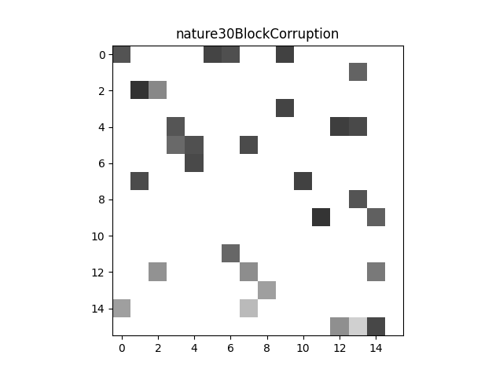
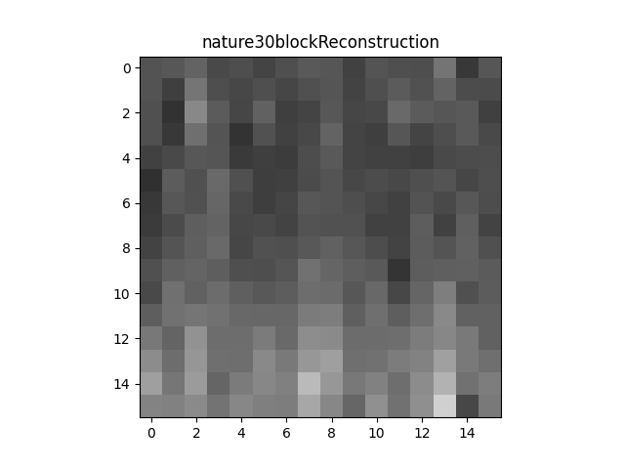
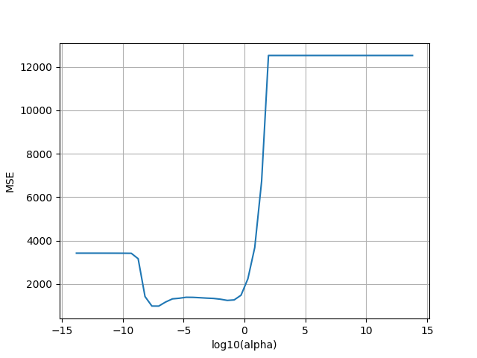
Nature Block Reconstruction (S=30)
The images presented on this slide illustrate the full reconstruction for the block of the nature image shown on the previous slide. The corruption process was performed on the block, with 30 of the 256 pixels left sensed. 226 pixels were selected at random and set to NaN to simulate data loss and corruption. The result is shown in the upper left image. Then, the image was reconstructed using LASSO regression, resulting in the upper right plot. The corrupted image was rasterized to produce a column vector. Then, the basis vector matrix was modified to only include the basis vectors whose x, y position correspond to the valid pixels in the corrupted image. Next, random subset cross validation was performed to select a regularization parameter for the block. The sensed pixels were grouped into training and testing folds. Floor(S/6) pixels were drawn for the testing fold at random. In this case, floor(30/6) = 5. The remaining 25 of the sensed pixels were used to train the model (30-5) . This process was repeated 20 times to produce a model resistant to specific datapoint variance. Alpha values ranged from 10^-6 to 10^6, with 3 values per log decade. Then, a Lasso regularization model was fit to the training fold using SciKitLearn’s Lasso model for each alpha value. This model did not fit an intercept so that the bias would not offset the pixel values and produce poor results. The input features X, are the basis vectors corresponding to the sensed pixels that were grouped into the training fold. The input labels are the corresponding pixel values for these training pixels. The LASSO model fits a set of weight coefficients to the basis vector matrix so that each pixel value can be represented as a weighted sum of the basis vectors. The performance of each model was analyzed by computing the Mean Square Error (Difference in pixel prediction and actual value in the image squared, averaged across the total number of predicted pixels) across the testing pixels. The model performance versus regularization parameter value is depicted in the bottom right plot. It was generated from this list of model scores versus alpha values within a block. As can be seen, the value of alpha that minimized the MSE was ~10^-6. This optimal model was then selected as the model to reconstruct the missing pixels. The dot product of the weight vector from the optimal LASSO model and the basis vector corresponding to the x,y position of each missing pixel yielded the reconstructed pixel value. The image in the top right illustrates the reconstruction of the block using this method. Comparing to the original block on the previous slide, the reconstruction performance is poor. The general idea that there is a transition between a light region and dark region as one moves down the image from the top is presented. But, the border is not nearly intense enough to fully rereport the shape and color disparity in the boundary as is in the initial block. It appears moreso as a top-down greyscale gradient than a sharp transition. This result makes sense, as the corrupted block provides almost 0 information about the complete block to the naked eye.
Corrupted Block

Slide 20
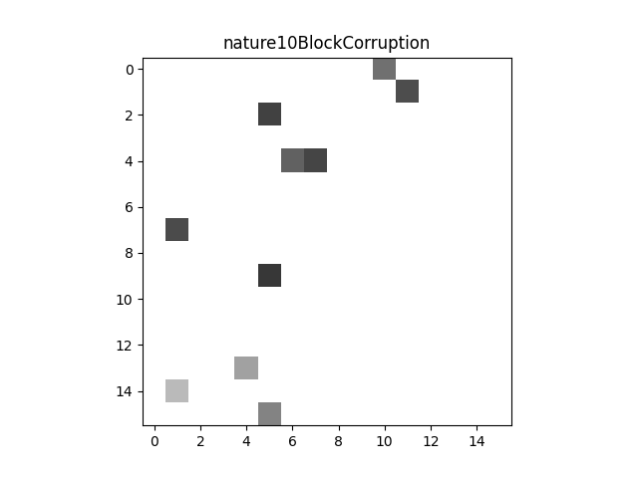
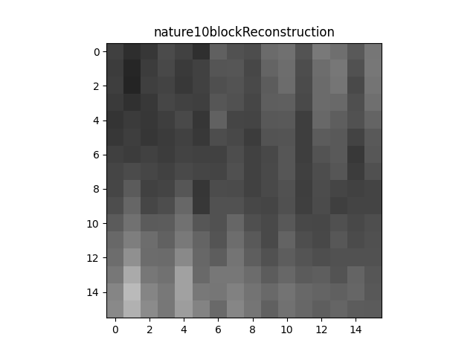
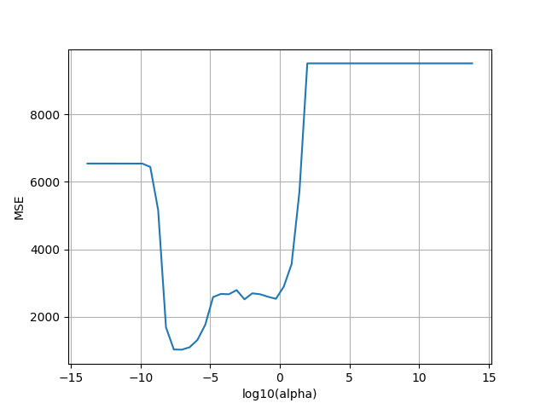
Nature Block Reconstruction (S=10)
The images presented on this slide illustrate the full reconstruction for the block of the nature image shown on the previous slide. The corruption process was performed on the block, with 10 of the 256 pixels left sensed. 246 pixels were selected at random and set to NaN to simulate data loss and corruption. The result is shown in the upper left image. Then, the image was reconstructed using LASSO regression, resulting in the upper right plot. The corrupted image was rasterized to produce a column vector. Then, the basis vector matrix was modified to only include the basis vectors whose x, y position correspond to the valid pixels in the corrupted image. Next, random subset cross validation was performed to select a regularization parameter for the block. The sensed pixels were grouped into training and testing folds. Floor(S/6) pixels were drawn for the testing fold at random. In this case, floor(10/6) = 1. The remaining 9 of the sensed pixels were used to train the model (10-1) . This process was repeated 20 times to produce a model resistant to specific datapoint variance. Alpha values ranged from 10^-6 to 10^6, with 3 values per log decade. Then, a Lasso regularization model was fit to the training fold using SciKitLearn’s Lasso model for each alpha value. This model did not fit an intercept so that the bias would not offset the pixel values and produce poor results. The input features X, are the basis vectors corresponding to the sensed pixels that were grouped into the training fold. The input labels are the corresponding pixel values for these training pixels. The LASSO model fits a set of weight coefficients to the basis vector matrix so that each pixel value can be represented as a weighted sum of the basis vectors. The performance of each model was analyzed by computing the Mean Square Error (Difference in pixel prediction and actual value in the image squared, averaged across the total number of predicted pixels) across the testing pixels. The model performance versus regularization parameter value is depicted in the bottom right plot. It was generated from this list of model scores versus alpha values within a block. As can be seen, the value of alpha that minimized the MSE was ~10^-6. This optimal model was then selected as the model to reconstruct the missing pixels. The dot product of the weight vector from the optimal LASSO model and the basis vector corresponding to the x,y position of each missing pixel yielded the reconstructed pixel value. The image in the top right illustrates the reconstruction of the block using this method. Comparing to the original block on the previous slide, the reconstruction performance is poor. The previous S=30 case was able to at least indicate the presence of a color shift as one moves down the image – a key feature in the initial image block. This reconstruction appears more homogenized, with lighter coloration present only in some of the corners. This result is to be expected, as so few of the initial pixels were present following the corruption.
Corrupted Block

Slide 21
Image Level Reconstruction

Slide 22


Fishing Boat Image Reconstruction (S=50) Upper Left - corrupted image. Lower Left – Reconstruction without median filter (MSE: 32.152) Lower Right - Reconstruction with median filter (MSE: 124.061)

Slide 23
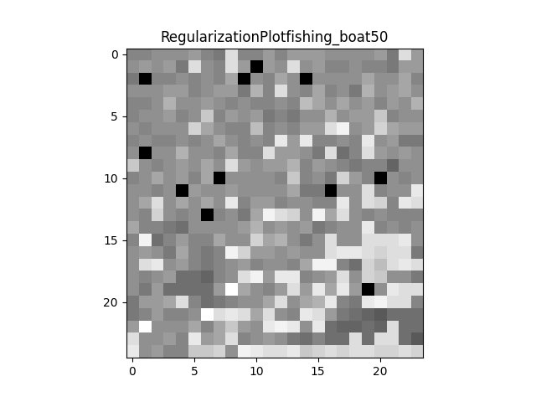
Fishing Boat Regularization Plot (S=50)
The plot presented on this slide provides a visualization of the regularization parameters for the LASSO models fit to each block of the original image. There is a model trained on each block , with the regularization parameter value selected by the random-subset cross validation routine that tries a logarithmically spaced range of alpha values from 10^-6 to 10^6. The alpha values for each block were saved in a 2D matrix such that the coordinates of a parameter value correspond to the coordinates of the block for which it was used in the original image. As the original fishing boat image is 200x192, the plot has dimensions 25x24, as there are this many 8-pixel long blocks in the x and y directions. In order to present a visualization, the alpha values were transformed into values in the range 0,255. The output alpha values ranged minimally and were very close to 0, so without this transformation the plot would fail to illustrate any comparisons between values. The smallest value was set to 0 and the largest set to 255 from the list. The remaining values were mapped according to a linear spacing between these two endpoints. The lighter the pixel color in the plot, the higher the regularization parameter was for that block in the initial image. High regularization parameters exist corresponding to regions in the image that exhibit high variance (the boat stripes, differing landscape intersections). Regions with high variance necessitate a higher regularization parameter value as the model testing phase will punish an overfit model on the new testing data. A model that attempts to perfectly fit pixel variations will perform poorly on new pixels. This allows a higher regularization parameter value to be selected in order to diminish this misclassification effect.

Slide 24


Fishing Boat Image Reconstruction (S=40) Upper Left - corrupted image. Lower Left – Reconstruction without median filter (MSE: 83.473) Lower Right - Reconstruction with median filter (MSE: 150.367)

Slide 25
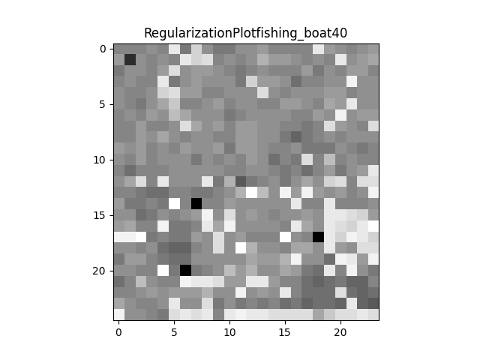
Fishing Boat Regularization Plot (S=40)
The plot presented on this slide provides a visualization of the regularization parameters for the LASSO models fit to each block of the original image. There is a model trained on each block , with the regularization parameter value selected by the random-subset cross validation routine that tries a logarithmically spaced range of alpha values from 10^-6 to 10^6. The alpha values for each block were saved in a 2D matrix such that the coordinates of a parameter value correspond to the coordinates of the block for which it was used in the original image. As the original fishing boat image is 200x192, the plot has dimensions 25x24, as there are this many 8-pixel long blocks in the x and y directions. In order to present a visualization, the alpha values were transformed into values in the range 0,255. The output alpha values ranged minimally and were very close to 0, so without this transformation the plot would fail to illustrate any comparisons between values. The smallest value was set to 0 and the largest set to 255 from the list. The remaining values were mapped according to a linear spacing between these two endpoints. The lighter the pixel color in the plot, the higher the regularization parameter was for that block in the initial image. High regularization parameters exist corresponding to regions in the image that exhibit high variance (the boat stripes, differing landscape intersections). Regions with high variance necessitate a higher regularization parameter value as the model testing phase will punish an overfit model on the new testing data. A model that attempts to perfectly fit pixel variations will perform poorly on new pixels. This allows a higher regularization parameter value to be selected in order to diminish this misclassification effect. This plot appears darker on average than the one produced with S=50. This is due to the fact that there is less variance as the number of sensed pixels diminishes. Quick changes are less likely to be captures in the sensed pixels, so the pixels remaining will most likely represent the large shapes in the original image instead.

Slide 26


Fishing Boat Image Reconstruction (S=30) Upper Left - corrupted image. Lower Left – Reconstruction without median filter (MSE: 83.473) Lower Right - Reconstruction with median filter (MSE: 150.367)

Slide 27
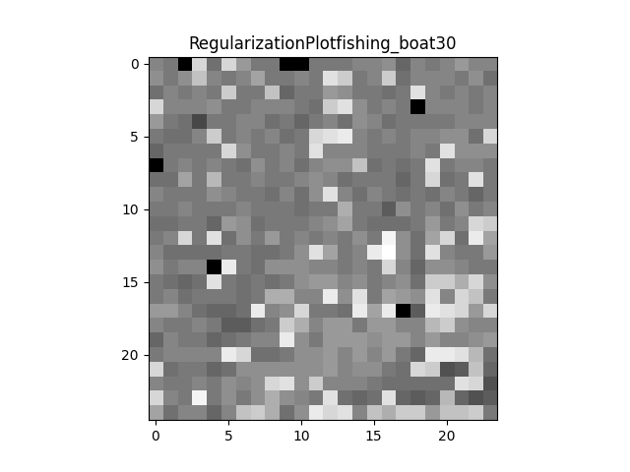
Fishing Boat Regularization Plot (S=30)
The plot presented on this slide provides a visualization of the regularization parameters for the LASSO models fit to each block of the original image. There is a model trained on each block , with the regularization parameter value selected by the random-subset cross validation routine that tries a logarithmically spaced range of alpha values from 10^-6 to 10^6. The alpha values for each block were saved in a 2D matrix such that the coordinates of a parameter value correspond to the coordinates of the block for which it was used in the original image. As the original fishing boat image is 200x192, the plot has dimensions 25x24, as there are this many 8-pixel long blocks in the x and y directions. In order to present a visualization, the alpha values were transformed into values in the range 0,255. The output alpha values ranged minimally and were very close to 0, so without this transformation the plot would fail to illustrate any comparisons between values. The smallest value was set to 0 and the largest set to 255 from the list. The remaining values were mapped according to a linear spacing between these two endpoints. The lighter the pixel color in the plot, the higher the regularization parameter was for that block in the initial image. High regularization parameters exist corresponding to regions in the image that exhibit high variance (the boat stripes, differing landscape intersections). Regions with high variance necessitate a higher regularization parameter value as the model testing phase will punish an overfit model on the new testing data. A model that attempts to perfectly fit pixel variations will perform poorly on new pixels. This allows a higher regularization parameter value to be selected in order to diminish this misclassification effect. This plot appears darker on average than the one produced with S=40. This is due to the fact that there is less variance as the number of sensed pixels diminishes. Quick changes are less likely to be captures in the sensed pixels, so the pixels remaining will most likely represent the large shapes in the original image instead.

Slide 28


Fishing Boat Image Reconstruction (S=20) Upper Left - corrupted image. Lower Left – Reconstruction without median filter (MSE: 336.061) Lower Right - Reconstruction with median filter (MSE: 325.128)

Slide 29
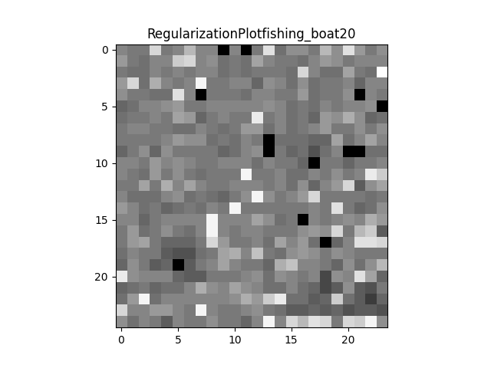
Fishing Boat Regularization Plot (S=20)
The plot presented on this slide provides a visualization of the regularization parameters for the LASSO models fit to each block of the original image. There is a model trained on each block , with the regularization parameter value selected by the random-subset cross validation routine that tries a logarithmically spaced range of alpha values from 10^-6 to 10^6. The alpha values for each block were saved in a 2D matrix such that the coordinates of a parameter value correspond to the coordinates of the block for which it was used in the original image. As the original fishing boat image is 200x192, the plot has dimensions 25x24, as there are this many 8-pixel long blocks in the x and y directions. In order to present a visualization, the alpha values were transformed into values in the range 0,255. The output alpha values ranged minimally and were very close to 0, so without this transformation the plot would fail to illustrate any comparisons between values. The smallest value was set to 0 and the largest set to 255 from the list. The remaining values were mapped according to a linear spacing between these two endpoints. The lighter the pixel color in the plot, the higher the regularization parameter was for that block in the initial image. High regularization parameters exist corresponding to regions in the image that exhibit high variance (the boat stripes, differing landscape intersections). Regions with high variance necessitate a higher regularization parameter value as the model testing phase will punish an overfit model on the new testing data. A model that attempts to perfectly fit pixel variations will perform poorly on new pixels. This allows a higher regularization parameter value to be selected in order to diminish this misclassification effect. This plot appears darker on average than the one produced with S=30. This is due to the fact that there is less variance as the number of sensed pixels diminishes. Quick changes are less likely to be captures in the sensed pixels, so the pixels remaining will most likely represent the large shapes in the original image instead.

Slide 30


Fishing Boat Image Reconstruction (S=10) Upper Left - corrupted image. Lower Left – Reconstruction without median filter (MSE:758.704) Lower Right - Reconstruction with median filter (MSE:596.098)

Slide 31
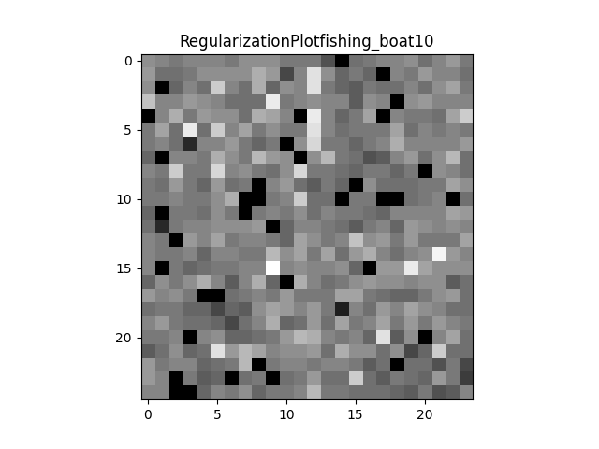
Fishing Boat Regularization Plot (S=10)
The plot presented on this slide provides a visualization of the regularization parameters for the LASSO models fit to each block of the original image. There is a model trained on each block , with the regularization parameter value selected by the random-subset cross validation routine that tries a logarithmically spaced range of alpha values from 10^-6 to 10^6. The alpha values for each block were saved in a 2D matrix such that the coordinates of a parameter value correspond to the coordinates of the block for which it was used in the original image. As the original fishing boat image is 200x192, the plot has dimensions 25x24, as there are this many 8-pixel long blocks in the x and y directions. In order to present a visualization, the alpha values were transformed into values in the range 0,255. The output alpha values ranged minimally and were very close to 0, so without this transformation the plot would fail to illustrate any comparisons between values. The smallest value was set to 0 and the largest set to 255 from the list. The remaining values were mapped according to a linear spacing between these two endpoints. The lighter the pixel color in the plot, the higher the regularization parameter was for that block in the initial image. High regularization parameters exist corresponding to regions in the image that exhibit high variance (the boat stripes, differing landscape intersections). Regions with high variance necessitate a higher regularization parameter value as the model testing phase will punish an overfit model on the new testing data. A model that attempts to perfectly fit pixel variations will perform poorly on new pixels. This allows a higher regularization parameter value to be selected in order to diminish this misclassification effect. This plot appears darker on average than the one produced with S=20. This is due to the fact that there is less variance as the number of sensed pixels diminishes. Quick changes are less likely to be captures in the sensed pixels, so the pixels remaining will most likely represent the large shapes in the original image instead.

Slide 32


Nature Image Reconstruction (S=150) Upper Left - corrupted image. Lower Left – Reconstruction without median filter (MSE:139.440) Lower Right - Reconstruction with median filter (MSE:253.803)

Slide 33

Nature Regularization Plot (S= 150)
The plot presented on this slide provides a visualization of the regularization parameters for the LASSO models fit to each block of the original image. There is a model trained on each block , with the regularization parameter value selected by the random-subset cross validation routine that tries a logarithmically spaced range of alpha values from 10^-6 to 10^6. The alpha values for each block were saved in a 2D matrix such that the coordinates of a parameter value correspond to the coordinates of the block for which it was used in the original image. As the original nature image is 512x640 , the plot has dimensions 32x40, as there are this many 16-pixel long blocks in the x and y directions. In order to present a visualization, the alpha values were transformed into values in the range 0,255. The output alpha values ranged minimally and were very close to 0, so without this transformation the plot would fail to illustrate any comparisons between values. The smallest value was set to 0 and the largest set to 255 from the list. The remaining values were mapped according to a linear spacing between these two endpoints. The lighter the pixel color in the plot, the higher the regularization parameter was for that block in the initial image. High regularization parameters exist corresponding to regions in the image that exhibit high variance (the landscape intersections, the water reflections, the rock details). Regions with high variance necessitate a higher regularization parameter value as the model testing phase will punish an overfit model on the new testing data. A model that attempts to perfectly fit pixel variations will perform poorly on new pixels. This allows a higher regularization parameter value to be selected in order to diminish this misclassification effect.

Slide 34


Nature Image Reconstruction (S=100) Upper Left - corrupted image. Lower Left – Reconstruction without median filter (MSE:243.891) Lower Right - Reconstruction with median filter (MSE:306.943)

Slide 35

Nature Regularization Plot (S= 100)
The plot presented on this slide provides a visualization of the regularization parameters for the LASSO models fit to each block of the original image. There is a model trained on each block , with the regularization parameter value selected by the random-subset cross validation routine that tries a logarithmically spaced range of alpha values from 10^-6 to 10^6. The alpha values for each block were saved in a 2D matrix such that the coordinates of a parameter value correspond to the coordinates of the block for which it was used in the original image. As the original nature image is 512x640 , the plot has dimensions 32x40, as there are this many 16-pixel long blocks in the x and y directions. In order to present a visualization, the alpha values were transformed into values in the range 0,255. The output alpha values ranged minimally and were very close to 0, so without this transformation the plot would fail to illustrate any comparisons between values. The smallest value was set to 0 and the largest set to 255 from the list. The remaining values were mapped according to a linear spacing between these two endpoints. The lighter the pixel color in the plot, the higher the regularization parameter was for that block in the initial image. High regularization parameters exist corresponding to regions in the image that exhibit high variance (the landscape intersections, the water reflections, the rock details). Regions with high variance necessitate a higher regularization parameter value as the model testing phase will punish an overfit model on the new testing data. A model that attempts to perfectly fit pixel variations will perform poorly on new pixels. This allows a higher regularization parameter value to be selected in order to diminish this misclassification effect. This plot appears darker on average than the one produced with S=150. This is due to the fact that there is less variance as the number of sensed pixels diminishes. Quick changes are less likely to be captures in the sensed pixels, so the pixels remaining will most likely represent the large shapes in the original image instead.

Slide 36


Nature Image Reconstruction (S=50) Upper Left - corrupted image. Lower Left – Reconstruction without median filter (MSE:407.401) Lower Right - Reconstruction with median filter (MSE:404.174)

Slide 37

Nature Regularization Plot (S= 50)
The plot presented on this slide provides a visualization of the regularization parameters for the LASSO models fit to each block of the original image. There is a model trained on each block , with the regularization parameter value selected by the random-subset cross validation routine that tries a logarithmically spaced range of alpha values from 10^-6 to 10^6. The alpha values for each block were saved in a 2D matrix such that the coordinates of a parameter value correspond to the coordinates of the block for which it was used in the original image. As the original nature image is 512x640 , the plot has dimensions 32x40, as there are this many 16-pixel long blocks in the x and y directions. In order to present a visualization, the alpha values were transformed into values in the range 0,255. The output alpha values ranged minimally and were very close to 0, so without this transformation the plot would fail to illustrate any comparisons between values. The smallest value was set to 0 and the largest set to 255 from the list. The remaining values were mapped according to a linear spacing between these two endpoints. The lighter the pixel color in the plot, the higher the regularization parameter was for that block in the initial image. High regularization parameters exist corresponding to regions in the image that exhibit high variance (the landscape intersections, the water reflections, the rock details). Regions with high variance necessitate a higher regularization parameter value as the model testing phase will punish an overfit model on the new testing data. A model that attempts to perfectly fit pixel variations will perform poorly on new pixels. This allows a higher regularization parameter value to be selected in order to diminish this misclassification effect. This plot appears darker on average than the one produced with S=100. This is due to the fact that there is less variance as the number of sensed pixels diminishes. Quick changes are less likely to be captures in the sensed pixels, so the pixels remaining will most likely represent the large shapes in the original image instead.

Slide 38


Nature Image Reconstruction (S=30) Upper Left - corrupted image. Lower Left – Reconstruction without median filter (MSE:553.131) Lower Right - Reconstruction with median filter (MSE:510.239)

Slide 39

Nature Regularization Plot (S= 30)
The plot presented on this slide provides a visualization of the regularization parameters for the LASSO models fit to each block of the original image. There is a model trained on each block , with the regularization parameter value selected by the random-subset cross validation routine that tries a logarithmically spaced range of alpha values from 10^-6 to 10^6. The alpha values for each block were saved in a 2D matrix such that the coordinates of a parameter value correspond to the coordinates of the block for which it was used in the original image. As the original nature image is 512x640 , the plot has dimensions 32x40, as there are this many 16-pixel long blocks in the x and y directions. In order to present a visualization, the alpha values were transformed into values in the range 0,255. The output alpha values ranged minimally and were very close to 0, so without this transformation the plot would fail to illustrate any comparisons between values. The smallest value was set to 0 and the largest set to 255 from the list. The remaining values were mapped according to a linear spacing between these two endpoints. The lighter the pixel color in the plot, the higher the regularization parameter was for that block in the initial image. High regularization parameters exist corresponding to regions in the image that exhibit high variance (the landscape intersections, the water reflections, the rock details). Regions with high variance necessitate a higher regularization parameter value as the model testing phase will punish an overfit model on the new testing data. A model that attempts to perfectly fit pixel variations will perform poorly on new pixels. This allows a higher regularization parameter value to be selected in order to diminish this misclassification effect. This plot appears darker on average than the one produced with S=50. This is due to the fact that there is less variance as the number of sensed pixels diminishes. Quick changes are less likely to be captures in the sensed pixels, so the pixels remaining will most likely represent the large shapes in the original image instead.

Slide 40


Nature Image Reconstruction (S=10) Upper Left - corrupted image. Lower Left – Reconstruction without median filter (MSE:910.336) Lower Right - Reconstruction with median filter (MSE:801.930)

Slide 41

Nature Regularization Plot (S= 10)
The plot presented on this slide provides a visualization of the regularization parameters for the LASSO models fit to each block of the original image. There is a model trained on each block , with the regularization parameter value selected by the random-subset cross validation routine that tries a logarithmically spaced range of alpha values from 10^-6 to 10^6. The alpha values for each block were saved in a 2D matrix such that the coordinates of a parameter value correspond to the coordinates of the block for which it was used in the original image. As the original nature image is 512x640 , the plot has dimensions 32x40, as there are this many 16-pixel long blocks in the x and y directions. In order to present a visualization, the alpha values were transformed into values in the range 0,255. The output alpha values ranged minimally and were very close to 0, so without this transformation the plot would fail to illustrate any comparisons between values. The smallest value was set to 0 and the largest set to 255 from the list. The remaining values were mapped according to a linear spacing between these two endpoints. The lighter the pixel color in the plot, the higher the regularization parameter was for that block in the initial image. High regularization parameters exist corresponding to regions in the image that exhibit high variance (the landscape intersections, the water reflections, the rock details). Regions with high variance necessitate a higher regularization parameter value as the model testing phase will punish an overfit model on the new testing data. A model that attempts to perfectly fit pixel variations will perform poorly on new pixels. This allows a higher regularization parameter value to be selected in order to diminish this misclassification effect. This plot appears darker on average than the one produced with S=30. This is due to the fact that there is less variance as the number of sensed pixels diminishes. Quick changes are less likely to be captures in the sensed pixels, so the pixels remaining will most likely represent the large shapes in the original image instead.

Slide 42
Image Reconstruction Performance

Slide 43

Fishing Boat (Mean Squared Error (MSE) versus number of sensed pixels (S)).
The presented plot illustrates a plotting of the number of sensed pixels (S) versus the Mean Squared Error (MSE) for the fishing boat image. The number of sensed pixels refers to the number of pixels per block whose values are not set to NaN and corrupted during the corruption process. The MSE is calculated by averaging the square of the difference between the pixel prediction and actual value between the reconstruction and original images over the total number of pixels. The curves shown indicate this trend for the reconstruction prior to median filtering and post median filtering. Across both curves, the MSE clearly decreases with an increase in S. This is to be expected, as more sensed pixels provides the LASSO models more data to train on and captures more of the nuance in the original image block. It appears that this curve’s derivative begins to level off past 40 pixels on both. This also makes sense as there is likely a number of pixels needed to reconstruct the image well, and beyond this further performance improvements are marginal. The median filter harms the accuracies for very small values of S, but surpasses the raw reconstruction as S grows past 20. The median filter blurs and homogenizes the pixel values, so in cases with few sensed pixels it makes sense that using the predictions based on them to smooth the image may not work. If the predictions are bad, they will reflect acr0ss the entire image and affect the values of the pixels that were actually sensed. If there is no median filter, the sensed pixels will remain constant and poor predictions are localized to a per-pixel level. As S goes up and the likelihood of poor predictions diminishes, this smoothing effect helps refine boundaries and shifts in the image

Slide 44

Nature (Mean Squared Error (MSE) versus number of sensed pixels (S)).
The presented plot illustrates a plotting of the number of sensed pixels (S) versus the Mean Squared Error (MSE) for the nature image. The number of sensed pixels refers to the number of pixels per block whose values are not set to NaN and corrupted during the corruption process. The MSE is calculated by averaging the square of the difference between the pixel prediction and actual value between the reconstruction and original images over the total number of pixels. The curves shown indicate this trend for the reconstruction prior to median filtering and post median filtering. Across both curves, the MSE clearly decreases with an increase in S. This is to be expected, as more sensed pixels provides the LASSO models more data to train on and captures more of the nuance in the original image block. It appears that this curve’s derivative begins to level off past 100 pixels on both. This also makes sense as there is likely a number of pixels needed to reconstruct the image well, and beyond this further performance improvements are marginal. The median filter harms the accuracies for very small values of S, but surpasses the raw reconstruction as S grows past 40. The median filter blurs and homogenizes the pixel values, so in cases with few sensed pixels it makes sense that using the predictions based on them to smooth the image may not work. If the predictions are bad, they will reflect acr0ss the entire image and affect the values of the pixels that were actually sensed. If there is no median filter, the sensed pixels will remain constant and poor predictions are localized to a per-pixel level. As S goes up and the likelihood of poor predictions diminishes, this smoothing effect helps refine boundaries and shifts in the image

Slide 45

Holistic MSE Performance (Mean Squared Error (MSE) versus number of sensed pixels (S) divided by Block Size (K)^2)
The plot presented on this page illustrates the MSE versus the percentage of pixels that are sensed per block. Plotting MSE versus percentage of sensed pixels allows for cross-image performance comparisons. Without normalizing by the total number of pixels in a block, comparisons would not make sense as the S values for nature range higher than those for the fishing boat as the blocks simply contain more pixels. The raw LASSO reconstruction and median filtering following the LASSO reconstruction are presented for both images. The trends relating median filtering versus raw reconstruction performance are the same as those indicated on the previous slide, with the median filtering only assisting the model after a critical percentage of the pixels are sensed for reconstruction (represented as the intersection of the 2 reconstruction curves for an image). For the nature image this is 20%, while for the boat image this is 40%. This indicates that the boat image likely displays more variance, as blending is more helpful if there is lower variance between adjacent pixels. This is also supported by the fact that the fishing boat curves are steeper, thereby showing that including more pixels provides more help to the model than for the nature image. Incremental inclusion of additional pixels leading to larger performance gains means that the individual pixels provide more information per pixel in the fishing boat image. This means that there is likely more variance in the fishing boat pixels, as more of them are needed to reconstruct the general trends and shapes in the image. This is also due to the fact that the fishing boat image simply has less pixels. It is thereby of lower resolution, meaning each pixel represents a larger percentage of the information depicted in the image than in the nature data.

Slide 46
Explanation and Interpretation (Approach)

Slide 47
Underdetermined Linear Systems
Despite the unique 2D array structure of an image, it can be reshaped to a single column vector by performing a rasterization that stacks each column. So, an image can then be treated as a standard vector in a linear system of equations. The discrete cosine transformation allows an image to be represented in this manner, with the dot product of its basis vector matrix and a weights column vector containing a weight for each basis vector producing the full image as a rasterized column vector. When the full image is available, the unique weight vector that produced it can be recovered simply by multiplying the image vector by the inverse of the basis vector matrix. With the weight vector, we can reproduce the full image vector. So, it is of high importance in image reconstruction tasks to generate this weight vector or an approximation of it. If the image is corrupt and missing pixels, the system we must solve to produce the weights vector is underdetermined when we include only the rows corresponding to present pixel coordinates in the basis vector matrix. If S represents the number of sensed/present pixels in the corrupted image, then the product of an SxM basis vector matrix with the Mx1 weights column vector can only produce an output image vector of dimensions Sx1. Thus, this process cannot generate information about the non-sensed pixels that were corrupted. Thought of in the inverse sense, the inverse of the modified basis vector matrix times the corrupted image does not yield a unique weight vector, as locations in the image have been removed from the basis vector matrix, thus specifying a unique weight vector that provides information at those locations would not be possible.

Slide 48

LASSO (L1 Norm) Regularization
The recovery problem we wish to solve relies on determining the full weight vector for a corrupted image, but this system is inherently undetermined. Using the discrete cosine transform to represent an image often yields weight vectors with many zero/near zero weights for some basis vectors. So, we can constrain our search for a weight vector solution by choosing a sparse solution where many of the weight values are zero. We will ultimately use linear regression to determine a suitable weight vector for our corrupted image via attempting to fit a model that minimizes the mean squared error between the pixel values our model can predict and those that are sensed from the actual image. To avoid performing this regression on an underdetermined system, we use regularization in our model to increase the sparsity of the weight vector we fit. This will be computationally faster and yield a result that provides a unique solution. T0 push some of the weight values to 0, we add a regularization term to the regression. This adds a penalty proportional to the size of the weight coefficients, incentivizing the model to choose the smallest values possible. As shown below, the LASSO loss function includes the Mean Square Error for a typical linear regression with a regularization term – lambda times the function f(x). For LASSO, this f(x) function is the L1 norm. This means that the absolute value of each weight is used for the norm. The parameter lambda allows us to tune the influence of regularization on the overall loss function. Later in the project, cross validation will be used to select the appropriate value for lambda.
(Oymak, 2013)

Slide 49

LASSO (L1 Norm) Regularization (cont.)
L1 norm regularization is most appropriate for this project because it allows coefficient values to reach 0 exactly instead of just very small values. Ridge regression computes the L2 norm (square root of the sum of squares) of the coefficients for the regularization term. This method will not yield a sparse result as 0ften as LASSO regularization, so we select a LASSO term for this project. The below image represents why LASSO regression produces 0-valued coefficients more often than Ride regression. The square and circular level curves represent constant loss due to the regularization, as the L1 and L2 norms respectively are constant along them. If the loss function for regression is plotted on the same axes, the selected coefficient pair will be that which minimizes regression loss within the constrained regularization loss that lambda selects. Thus, the function will select a point of tangency between the regularization curve and regression loss function. The linear shape of the LASSO regression bounds means that a point of tangency will always lie on at least one axis, thereby selecting other coefficients to be exactly 0. The circular L2 norm case provides many more opportunities for tangency, selecting values near the axes instead of exactly 0.
(Zawar, 2020)

Slide 50
Application of LASSO
Lasso regression and regularization was applied in this project to solve for a full weight vector from the underdetermined linear system involving the corrupted image. For precision, each image was broken into square blocks of a fixed dimension and then the model was fit to each block. First, the corrupted image block had its NaN pixel values removed and was rasterized to produce a column vector. Then, the basis vector matrix had its rows corresponding to the x,y coordinates of the corrupted pixels removed. To determine the appropriate value for lambda in each block, random subset cross validation was conducted with 20 iterations. At each iteration, floor(S/6) of the sensed pixels were selected as a testing set, and the remaining S- floor(S/6) pixels were used as the training set. A LASSO model was trained on each value in the input range for lambda, and then scored based on mean square error between the sensed pixel values in the testing set and the model’s prediction. After averaging this MSE over 20 iterations, the lambda value with the lowest MSE total was chosen to be used for that block. Finally, a LASSO model with this optimal lambda was used to generate a weight vector representative of the block. Allowing the regularization to include a constant term could harm results, as selecting the mean value of the pixels for the constant and then all 0’s would be the likely outcome. So, the regularization term was not allowed access to the constant. In implementation, this involved using an option in SciKit Learn to tell the LASSO function not to generate an intercept. The missing pixels were then predicted by taking the dot product of the predicted weight vector with the row from the full basis vector matrix that corresponded to the x,y coordinate of the missing pixel. After performing these steps on every block of the image, coupled with a final median filter, image-level reconstruction was possible.

Slide 51
Use of Filtering
Following image recovery with LASSO, the full image can be reconstructed in a recognizable form. If the image could be segmented into every consecutive block for reconstruction, the final result would look cohesive at this point. However, due to computational constraints, the image was only reconstructed with contiguous blocks in this project. Thus, pixels that were reconstructed towards the edge of a given block are determined solely by the other pixels that they happened to be grouped into a block with when LASSO regression was performed. If a block missed a curvy boundary in the image, this may prevent pixels that it is more similar to from having influence on its value. So, we might expect some discontinuity and jagged-looking edges between block’s in the reconstructed image. This was seen in practice as the number of sensed pixels decreased, as it meant that more edge pixels needed to be predicted. The results would be particularly poor if color frequency in the underlying correct image rapidly changed along the border between 2 blocks. To remedy this, a median filter was applied. This assigns each pixel the value of the median of its neighbors. In this case, the 3x3 set of neighbors with the target pixel at its center was considered. This process allows pixels that are physically closer to influence the value of a particular pixel. Along the edge connections of blocks, the jagged appearance will be smoothed out as pixels from both blocks are neighbors, so the median values will provide a more seamless transition.

Slide 52
Selection of a Median Filter
As aforementioned, a filtering method was needed to make the reconstructed images appear smoother. There are many kinds of filters that could accomplish this, but a median filter specifically was used in this project for a number of reasons. First, the point of applying a filter is to make sure every pixel’s value is influenced by those that share the highest proximity to it. The median filter produces exactly that, as it assigns the pixel the median value of its neighbors. Frequency dependent methods can smooth out the image as well, as they can filter out the high-frequency shifts in pixel values that occur along jagged edges. But, this technique could potentially fail to include some of the higher frequency variations characteristic of the actual image. Some portions of the nature image, like the transition between the lighter water and its surrounding dark background, will naturally have a higher frequency. So, applying a low-pass filter to remove this high variation may distort the actual image. A high-pass filter would remove very low levels of variation, helping if a specific block became artificially homogenized in pixel value. This may also work against us, as there are large portions of both images where there is just naturally little variation in pixel intensity across an object. Median filtering can also handle outlying pixels better, as the value for each pixel depends equally on all its neighbors. Mean-centric methods would be more prone to outlier bias. So, the median filter will allow us to target the jagged edges where blocks are connected all while preserving the degree of natural frequency variation in each portion of the image.

Slide 53
Explanation and Interpretation (Results)

Slide 54
Regularization Parameter Variation Across the Image
The cross-validation routine performed in this project operated on the block level, this means that for every block in the image a value of alpha was selected that minimized the MSE across 20 cross validations. As the pixel contents of each block differed, it was possible to generate spatial representations of the relative values of alpha for each block, as shown in the results section. In a block with high levels of variation in the original image, the corresponding pixel on the regularization parameter visualization appears bright. This would mean that lambda took on a higher value for this case. In blocks with lower variation, there is a darker pixel for alpha, indicating a lower regularization parameter. This trend makes sense, as in cases with high image variance, choosing a weight vector that has more zero weights and is mostly constant could be more beneficial. If the model is overfit to the variant training pixels, there will be high variance when tested, thus producing higher MSEs. So, a more averaged model would win for this step of the cross validation. In the case of a smaller regularization parameter value, the model will be able to predict more nonzero weights and tune to the training pixels more finely. This approach will work if the target block of the image has low variance, as the testing pixels will represent those which the model was trained on better, producing a lower MSE than a more general averaged model.

Slide 55
Relationship Between Sensed Pixels (S) and Mean Squared Error (MSE)
The mean squared error is calculated by squaring the difference between the predicted pixel value and its value in the real image and then dividing out by the total number of pixels in the complete image. This yields an estimate of the error per pixel. If a pixel is sensed in the corruption process, it will have the same value in both the real and reconstructed image, since the LASSO model will not predict a new value for it during reconstruction. Thus, sensed pixels will contribute 0 mean squared error. Naturally, if we increase the number of sensed pixels, more pixels in the image contribute 0 error, so the MSE is bound to decrease. On all of the MSE versus S curves presented, the MSE falls with each increase in S. Additionally, having more sensed pixels will help with reconstructing the corrupted pixels more accurately. There is simply more data as S increases. So, there will be more pixels available to train the LASSO models for each block. This will generate a weight vector that represents more information from the original image than in cases where more pixels are missing. Thus, we would expect this to also decrease the MSE for the full image.

Slide 56
Impacts of Median Filtering
The median filter changes the value of every pixel in the reconstruction image to the median of its 3x3 neighbor block. This means that the sensed pixels which previously contributed 0 MSE in the non-filtered case will now contribute error to the image’s MSE. As such, if the reconstruction we produced happened to be a perfect reconstruction, we would actually expect the median filter to solely increase the MSE of our result. This will not be the case in practice, but there does seem to be scenarios in which the median filter does more harm than good. In the fishing boat and nature MSE vs S plots, it is clear that for higher values of S beyond the curve intersection, there is actually a lower MSE for the non-filtered reconstruction than the filtered one. This makes sense, as when we increase S we decrease the number of edge pixels that need to be predicted. This means that our reconstruction will be more of the sensed image in between blocks and will not have as many jagged edges. As the median filter was applied to correct jagged edges, the small number of them means that blurring the entire image together with the median filter will have more of a negative effect on MSE than the corrections made at sharp edges. So, it is clear that in cases where we are able to sense most of the image, it may not make sense to apply the filter. The MSE versus S/K^2 plot illustrates this a bit better. S/K^2 indicates the percentage of the original image that we are allowed to sense. The intersection point where the median filter does more harm than good appears at 20% for the nature image and 35% for the fishing boat. This suggests that applying a median filter to smooth out results is only favorable if just a small portion of the original image is available. In terms of aesthetic quality, the median filter does make all of the images appear smoother and more natural to me, though. The increase in MSE the filter may incur does not change the perceptibility of the image. So, choosing to use the filter should depend on which factor is more important for a specific application.

Slide 57
Collaborators
I discussed implementing random subset cross validation with the ShuffleSplit SciKitLearn method with Namh Lahade. In the class discussion for MP 1 feedback I spoke with Monty Truitt and Aarzu Gupta to understand how to properly reconstruct a a block of an image using LASSO regression. Aarzu informed me that in testing the model to select an alpha value, a prediction is generated only for the corrupted pixels, and not the sensed one. Monty informed me that in using the selected LASSO model to fill in the corrupted pixel values, only the missing values are predicted as well. I conveyed my new understanding to Reubben Baffoe, as he was unsure of the block-reconstruction process and had the same questions to which I had just figured out the answers. I compared reconstruction curves with Nahm Lahade, as I was unsure that my results which indicated that performance was generally better on the nature image made sense. We realized we shared the same result and were able to ponder and theorize that the resolution of the respective images contributed to this. We compared MSE values as well, to ensure that our respective models generally performed as they should.

Slide 58
Citations

Slide 59
Packages

Slide 60
Scikit-learn: Machine Learning in Python, Pedregosa et al., JMLR 12, pp. 2825-2830, 2011.
- Used Scikit-learn package to implement LASSO regression and Random Subset Cross Validation
"Matplotlib: A 2D Graphics Environment", Computing in Science & Engineering, vol. 9, no. 3, pp.
- Used Matplotlib package to plot all images and other plots
Harris, C.R., Millman, K.J., van der Walt, S.J. et al. Array programming with NumPy. Nature 585, 357– 362 (2020).
- Used Numpy package to store pixel information as manipulable arrays
Pauli Virtanen, Ralf Gommers, Travis E. Oliphant, Matt Haberland, Tyler Reddy, David Cournapeau, Evgeni Burovski, Pearu Peterson, Warren Weckesser, Jonathan Bright, Stéfan J. van der Walt, Matthew Brett, Joshua Wilson, K. Jarrod Millman, Nikolay Mayorov, Andrew R. J. Nelson, Eric Jones, Robert Kern, Eric Larson, CJ Carey, İlhan Polat, Yu Feng, Eric W. Moore, Jake VanderPlas, Denis Laxalde, Josef Perktold, Robert Cimrman, Ian Henriksen, E.A. Quintero, Charles R Harris, Anne M. Archibald, Antônio H. Ribeiro, Fabian Pedregosa, Paul van Mulbregt, and SciPy 1.0 Contributors. (2020) SciPy 1.0: Fundamental Algorithms for Scientific Computing in Python. Nature Methods, 17(3), 261-272.
- Used Scipy package to implement full-image median filtering

Slide 61
Other

Slide 62
Ahmed, Zawar. “Comparing Linear Regression Models: Lasso vs Ridge.” Medium, Medium, 6 May 2020, https://zawar-ahmed.medium.com/comparing-linear-regression-models-lasso-vs-ridge-60587ff5a5aa.
S. Oymak, C. Thrampoulidis and B. Hassibi, "The squared-error of generalized LASSO: A precise analysis," 2013 51st Annual Allerton Conference on Communication, Control, and Computing (Allerton), 2013, pp. 1002- 1009, doi: 10.1109/Allerton.2013.6736635.

